Slide 1
Overview of New Funding Model
May 17, 2013
Astana, Kazakhstan

Slide 2
Part I - Overview of NFM
Main features
Allocation methodology for indicative amount
Incentive funding
Disease split with HCSS
Country dialogue

Slide 3
Events leading up to the Board’s decision and implementation
When
Key event
Outcome
2011
New Global Fund Strategy approved
Established the framework to replace “Rounds” with a substantially changed funding model
2012
Decisions on New Funding model
Design and Agreement on all key features of the new model, with timelines for implementation
2013
Implementation
Launch transition: test elements of the new funding model
2014
Full implementation of the new funding model after replenishment

Slide 4
Disease programs fall into one of three categories
How they receive funding
What they do
Early
applicants
New grant: eligible for indicative and incentive funding
All steps of the new funding model process (e.g., allocation, country dialogue, concept note, TRP, and grant making)
1
Interim
applicants
Strategic reprogramming, Renewal and Extensions of existing grants: eligible for indicative funding
Select steps of the
New Funding Model process
(e.g., allocation, country dialogue, potentially TRP review)
2
Standard applicants
No new funds until after the replenishment conference
On-going country dialogue, including strengthening NSPs
3
Notes:
Participation of countries in the transition was based on:
Countries that are significantly “underfunded” over the 2013-2014 period. The Secretariat is currently developing a definition of “underfunded” and how this will be measured.
Countries that are positioned to achieve rapid impact; and finally
Countries whose programs are at risk of service interruptions.
It’s important to note that the Board has also stipulated that selected participants will be diverse in areas including size, geography, capacity and proposal modalities (including non-CCM and regional applicants)
This is so that lessons learned can be derived from all aspects of the funding model, including funding for underserved populations and MARPs*.

Slide 5
Overview of the new funding model
Determination
of split between diseases & HCSS
Unfunded quality demand
NSP
support
Grant Approval Committee
TRP
review
Board approval
NSP
Country dialogue
Concept Note
Determine / approve adjusted funding amount
Grant-making
Indicative funding
Incentive
funding
Band allocation
Allocation formula

Slide 6
NFM allocation formula
Country share =
Country score
Total scores of all countries
Notes:
Qualitative Factors Adjustments
Minimum Required Level
External Financing
Performance and Absorptive Capacity
Willingness to Pay
Risk
Increasing rates of infection

Slide 7
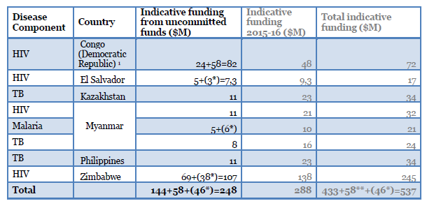
Indicative Amounts for Early Applicants

Slide 8
Kazakhstan: funding picture
Early applicant for TB
Allocated indicative amount of US$ 34 million
Plus can apply for ‘above indicative’ amount (full expression of demand)
funded by incentive funding (compete for US$ 28 million between 3 countries in second window
- register of unfunded quality demand
Focus 100 % of the budget on key populations and/or key interventions
Can ask for health systems strengthening (HSS) focused on key populations/interventions
Address gender, human rights issues
Notes:
being eligible in 2013 does not guarantee that a country will be eligible in 2014 (in particular UMIs) as we will redo eligibility prior to the full roll-out and will, if the policy does not change, need to request again latest available disease burden information from WHO and UNAIDS
Focus of proposals - must focus 100% of the proposal‘s budget on Special Groups and/or Interventions. Special Groups and/or Interventions in this context are defined as ‘underserved and most-at-risk populations‘ and/or ‘highest impact interventions within a defined epidemiological context’. Annex B of the ECFP policy defines what is meant by ‘Underserved and Most-At-Risk Populations’ and ‘Highest-Impact Interventions within a Defined Epidemiological Context’.
Underserved & most at risk defined as:
Defined within a defined and recognized epidemiological context
Have significantly higher levels of risk, mortality and/or morbidity; AND
Have significantly lower access to, or uptake of, relevant services is than the rest of the population
Highest impact interventions:
Defined within a defined and recognized epidemiological context
Address emerging threats to disease control, lift barriers to the broader disease response and/or create conditions for improve service delivery
And/or enable the roll-out of new technologies that represent best practice; AND
Are not adequately funded
Focus of HCSS - must maintain focus on key populations & also:
Improve equitable coverage and uptake addressing any/all
• Availability of services
• Access to services
• Utilization of services
• Quality of services
AND
Are not funded adequately

Slide 9
Ineligible
Remaining Demand
Compete for Incentive funding
‘Above Indicative’ Funding Request
For Kazakhstan = 34 million
Indicative Funding Request
Current Country Response
(based on current and anticipated resources)
Domestic Resources*
External Resources (Non-GF)
Signed GF Resources
* Includes Counterpart Financing
Funding request (in Concept Note)
Funding gap
Full expression of demand = full cost of national strategy for TB

Slide 10
Country Dialogue: two elements
National strategic plan: a full expression of prioritized demand
Country dialogue
Concept Note
Key elements of Country Dialogue process
Key Global Fund-specific
elements
Disease and health sector landscape
Documented evidence of impact
Human rights and inclusion
Partner & Global Fund investments
Country team (CT) communicates indicative funding
CT does pre-assessment
CCM holds discusses program split
Secretariat assesses CCM eligibility
CCM agrees on timelines (aligned with country planning cycles )
CCM develops concept note
Notes:
Disease and health sector landscape - forge a common understanding of a country's disease and health sector landscape including latest epidemiological studies and identifying data gaps; areas for coordination and partnership; and any weaknesses in health or community systems that could affect disease programs;
Documented evidence of impact - Conduct program evaluations and other research to determine outcomes and impact of programs including capacity assessments of health and community systems to deliver services;
Rights and inclusion: Assess any human rights issues, barriers to services and impediments to quality of services that impede performance and outcomes
Partner and global fund investments: Map the funding landscape and ensuring alignment and complementarity between donor and national funding in the overall budget for the disease response.

Slide 11
Your Questions?

Slide 12
Part II – Concept Note

Slide 13
Overview of the Concept Note
Principal document for review and grant-making purposes;
Output from country dialogue, reflective of an inclusive multi-stakeholder process;
Encourages robust and ambitious funding request;
Uses national strategy as the basis; and
Captures ‘’full expression of demand’’

Slide 14
Main Topics in the Concept Note
The CCM will submit the Concept Note
1
How the application development process complies with CCM Eligibility Requirements.
Key attachments
Financial Gap Analysis & Counterpart Financing Table
CCM endorsement of the Concept Note
Other supporting documentation (e.g. NSP)
2
An explanation of the country’s epidemiological situation and the current legal and policy environment, and how the National Strategic Plan responds to the country disease context.
3
How existing and anticipated programmatic gaps of the National Disease Strategic Plan have been identified
+
Instructions & Information Notes
Provide guidance to applicant on how to integrate key issues such as human rights, gender, SOGI, operational risk
4
How the funds requested will be strategically invested to maximize the impact of the response.
5
How the program will be implemented

Slide 15
Section 1
Concept note section
1
CCM Eligibility Requirements.
Purpose of this section
Show how the application development process complies with CCM eligibility requirements
What is asked of the applicant
The applicant will be asked to describe the following:
Application development process
PR nomination and selection process
Dual track financing
2
Country Context
3
Programmatic Gap Table
4
Funding Request to the Global Fund
5
Implementation Arrangements

Slide 16
Section 2
Concept note section
1
CCM Eligibility Requirements.
Purpose of this section
An explanation of the country’s epidemiological situation and the current legal and policy environment, and how the National Strategic Plan responds to the country context.
What is asked of the applicant
The applicant will be asked to describe the following:
Key affected populations
Factors that may cause inequity in access to services
System-related constraints
NSP goals, objectives, and priority interventions
Current stage of NSP implementation
Main findings of and response to any recent assessments or reviews of NSP
NSP outcome and impact, key stakeholders
Any limitations of the NSP response to date and lessons learned
Any limitations in national data systems to measure and demonstrate impact
Enhancing TB-HIV collaborative activities
2
Country Context
3
Programmatic Gap Table
4
Funding Request to the Global Fund
5
Implementation Arrangements

Slide 17
Section 3
Concept note section
1
CCM Eligibility Requirements.
Purpose of this section
Describe existing and anticipated programmatic gaps of the National Disease Strategic Plan have been identified
What is asked of the applicant
The applicant will be asked to complete the Programmatic Gap Table
The applicant will be asked to describe the following:
Assumptions, methodology, and sources used in estimating the programmatic gaps
2
Country Context
3
Programmatic Gap Table
4
Funding Request to the Global Fund
5
Implementation Arrangements

Slide 18
Section 4
Concept note section
1
CCM Eligibility Requirements.
Purpose of this section
Describe how the funds requested will be strategically invested to maximize the impact of the response.
What is asked of the applicant
The applicant will be asked to complete:
Modular Template
Funding Gap Analysis and Counterpart Financing Table
The applicant will be asked to describe the following:
How funding requested and any existing Global Fund financing will be invested or reprogrammed during the funding request period to maximize impact
For funding requested above the indicative funding amount: additional gains, objectives, and outcomes that could be realized and the additional proposed modules and interventions in order of priority
How the funding request will be complemented by funding from the Government and other donors
2
Country Context
3
Programmatic Gap Table
4
Funding Request to the Global Fund
5
Implementation Arrangements

Slide 19
Section 5
Concept note section
1
CCM Eligibility Requirements.
Purpose of this section
Describe how the program will be implemented
What is asked of the applicant
The applicant will be asked to complete the PR information and Minimum Standards check
The applicant will be asked to describe the following:
Links to other Concept Notes and/or existing grants
Overview of implementation arrangements between multiple PRs and/or SRs
Current or anticipated risks and/or limitations to the program and PR performance
Participation of women, communities, and other key affected populations in implementation
Major external risks
2
Country Context
3
Programmatic Gap Table
4
Funding Request to the Global Fund
5
Implementation Arrangements

Slide 20
Key Attachments
Financial Gap Analysis & Counterpart Financing Table
CCM endorsement of the Concept Note
Other supporting documentation (e.g. NSP)
Budget and performance framework are being incorporated into new version of concept note

Slide 21
Key Messages
Focus on high impact interventions
Base request on national strategy
Follow WHO recommendations
Formulate a full expression of demand for TB (and any HCSS included)
Include human right and gender issues
Analyze funding landscape and financial gap analysis

Slide 22
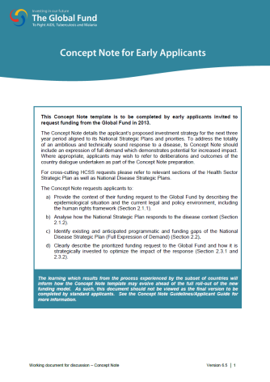
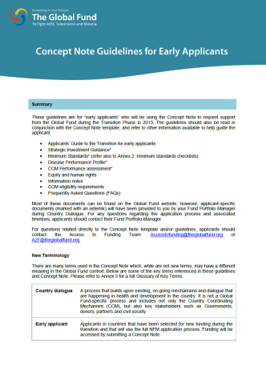
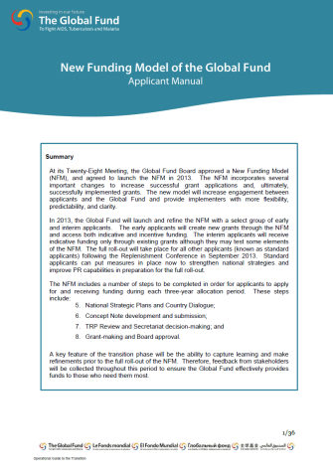
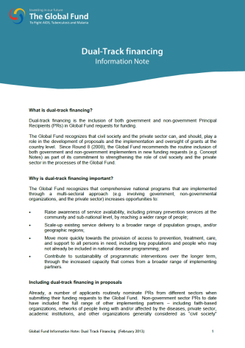
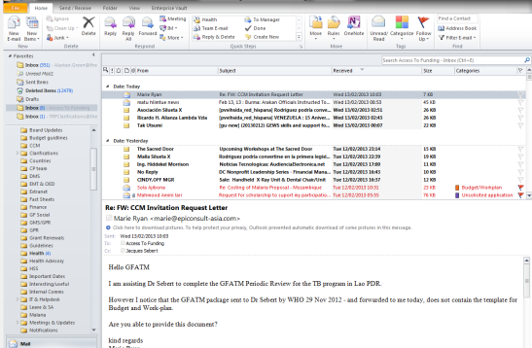
Supporting materials for Early Applicants
Concept Note
Concept Note
Instructions
Transition Manual
Information notes
Online FAQs
Access to Funding inbox
Strategic investment guidance from partners
+
a2f@theglobalfund.org
+
Direct support and training

Slide 23
Questions?

